Slide 2
Introduction to clustering models using R and Tidymodels
Speaker Name
Title
Follow along with this module at https://aka.ms/learn-clustering-with-R
Speaker Name
Title
Notes:
Link to published module on Learn: Explore and analyze data with R - Learn | Microsoft Docs

Slide 3
Learning objectives
  What is clustering
  Evaluate different type of clustering
  How to train and evaluate clustering models

Slide 4
What is clustering?

Slide 5
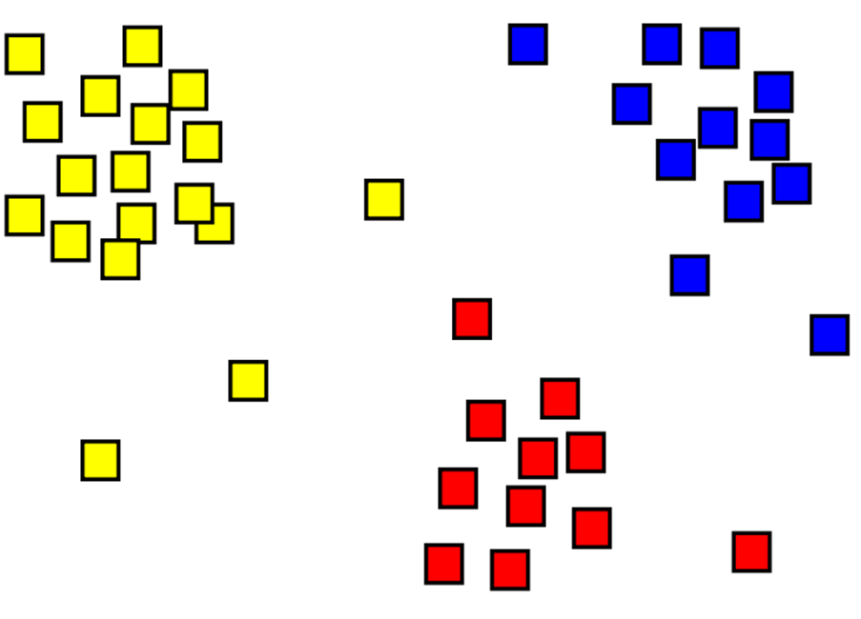
What is clustering?
Clustering is a form of unsupervised machine learning in which observations are grouped into clusters based on similarities in their features.
This is considered unsupervised because it does not make use of previously known label values to train a model.
Notes:
Clustering is the process of grouping objects with similar objects. For example, in the image below we have a collection of 2D coordinates that have been clustered into three categories - top left (yellow), bottom (red), and top right (blue).
A major difference between clustering and classification models is that clustering is an unsupervised method, where training is done without labels. Clustering models identify examples that have a similar collection of features. In the image above, examples that are in a similar location are grouped together.
Clustering is common and useful for exploring new data where patterns between data points, such as high-level categories, are not yet known. It's used in many fields that need to automatically label complex data, including analysis of social networks, brain connectivity, spam filtering, and so on.
Clustering is a form of unsupervised machine learning in which observations are grouped into clusters based on similarities in their data values, or features. This kind of machine learning is considered unsupervised because it does not make use of previously known label values to train a model; in a clustering model, the label is the cluster to which the observation is assigned, based purely on its features.

Slide 6
Evaluate different types of clustering

Slide 7
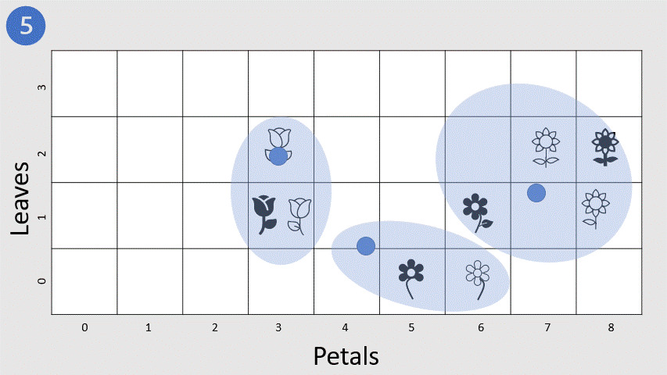
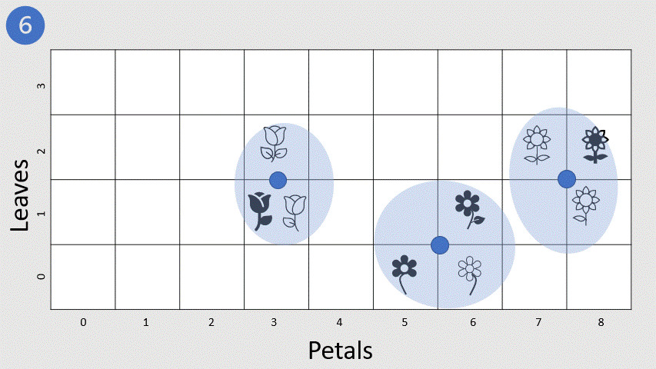
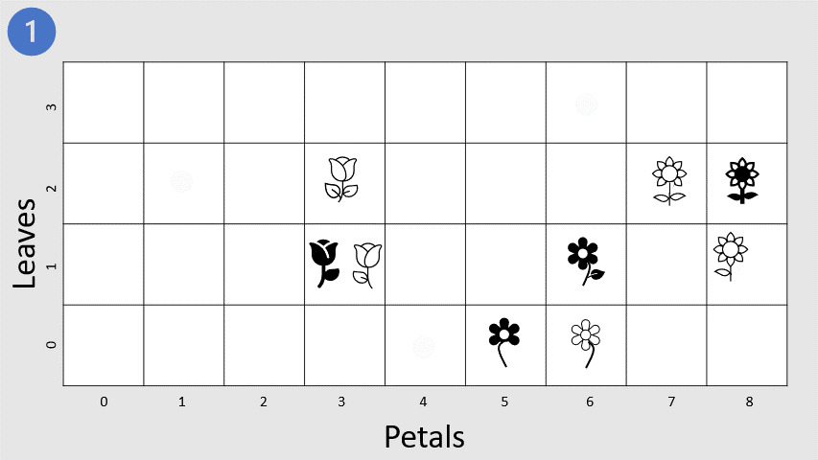
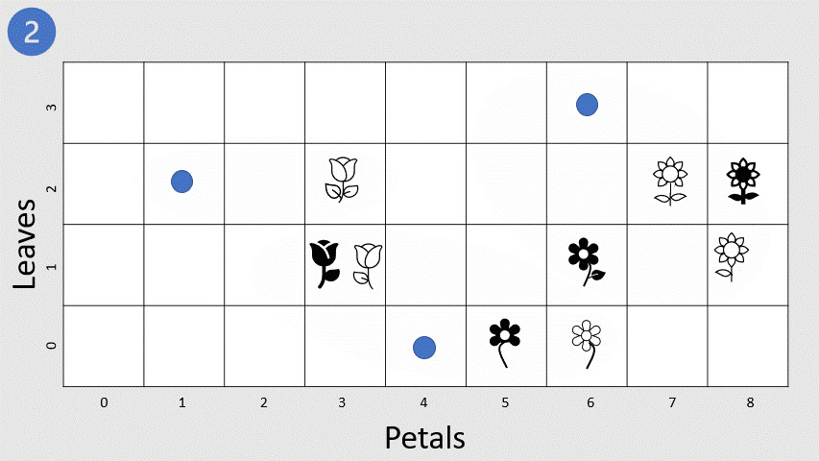
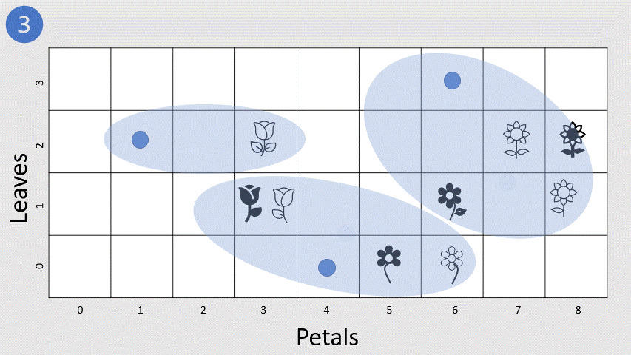
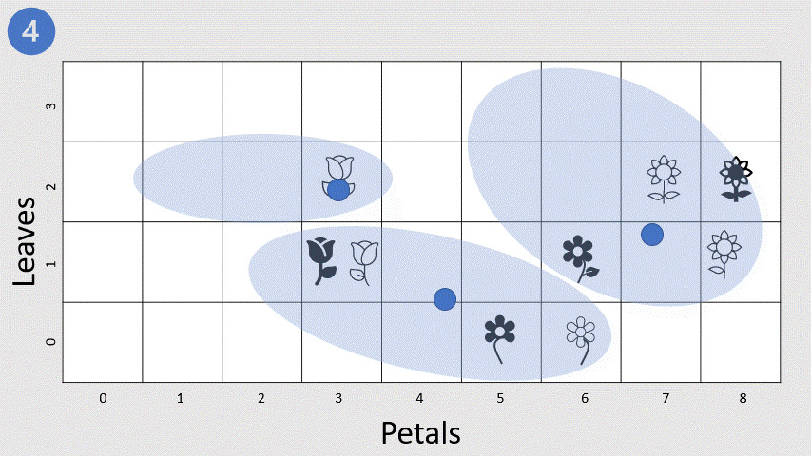
K-Means clustering
The data scientist specifies the number K of clusters.
The algorithm randomly selects K observations as the initial centroids for the clusters.
Each of the remaining observations are assigned to its closest centroid.
The new means of each cluster is computed and the centroid is moved to the mean.
The cluster assignment and centroid update steps are iteratively repeated until the cluster assignments stop changing.
It’s strongly recommended to always run K-Means with several values of nstart to avoid an undesirable local optimum.
Notes:
The algorithm we previously used to approximate the number of clusters in our data set is called K-Means. Let's get to the finer details, shall we?
The basic algorithm has the following steps:
Specify the number of clusters to be created (this is done by the data scientist). Taking the flowers example we used at the beginning of the lesson, this means deciding how many clusters you want to use to group the flowers.
Next, the algorithm randomly selects K observations from the data set to serve as the initial centers for the clusters (that is, centroids).
Each of the remaining observations (in this case flowers) are assigned to its closest centroid.
The new means of each cluster is computed and the centroid is moved to the mean.
Now that the centers have been recalculated, every observation is checked again to see if it might be closer to a different cluster. All the objects are reassigned again using the updated cluster means. The cluster assignment and centroid update steps are iteratively repeated until the cluster assignments stop changing (that is, when convergence is achieved). Typically, the algorithm terminates when each new iteration results in negligible movement of centroids and the clusters become static.
Note that due to randomization of the initial K observations used as the starting centroids, we can get slightly different results each time we apply the procedure. For this reason, most algorithms use several random starts and choose the iteration with the lowest within cluster sum of squares (WCSS). As such, it's strongly recommended to always run K-Means with several values of nstart to avoid an undesirable local optimum.
So, training usually involves multiple iterations, reinitializing the centroids each time, and the model with the best (lowest) WCSS is selected. The following animation shows this process:

Slide 8
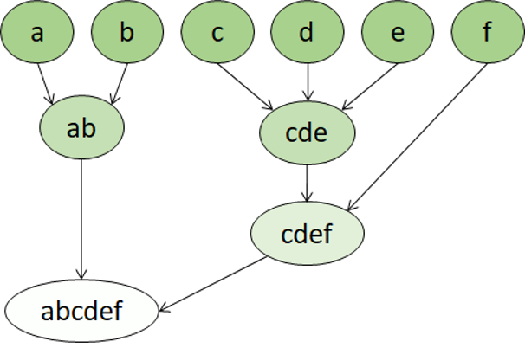
Hierarchical clustering
In hierarchical clustering, the clusters themselves belong to a larger group, which belong to even larger groups, and so on.
Data points can be clusters in differing degrees of precision: with a large number of very small and precise groups, or a small number of larger groups.
Notes:
The first step in K-Means clustering is the data scientist specifying the number of clusters K to partition the observations into. Hierarchical clustering is an alternative approach which doesn't require the number of clusters to be defined in advance.
In hierarchical clustering, the clusters themselves belong to a larger group, which belong to even larger groups, and so on. The result is that data points can be clusters in differing degrees of precision: with a large number of very small and precise groups, or a small number of larger groups.
For example, if we apply clustering to the meanings of words, we may get a group containing adjectives specific to emotions ('angry', 'happy', and so on), which itself belongs to a group containing all human-related adjectives ('happy', 'handsome', 'young'), and this belongs to an even higher group containing all adjectives ('happy', 'green', 'handsome', 'hard' etc.).
Hierarchical clustering is useful for not only breaking data into groups, but understanding the relationships between these groups. A major advantage of hierarchical clustering is that it doesn't require the number of clusters to be defined in advance, and can sometimes provide more interpretable results than non-hierarchical approaches. The major drawback is that these approaches can take much longer to compute than simpler approaches and sometimes are not suitable for large datasets.

Slide 9
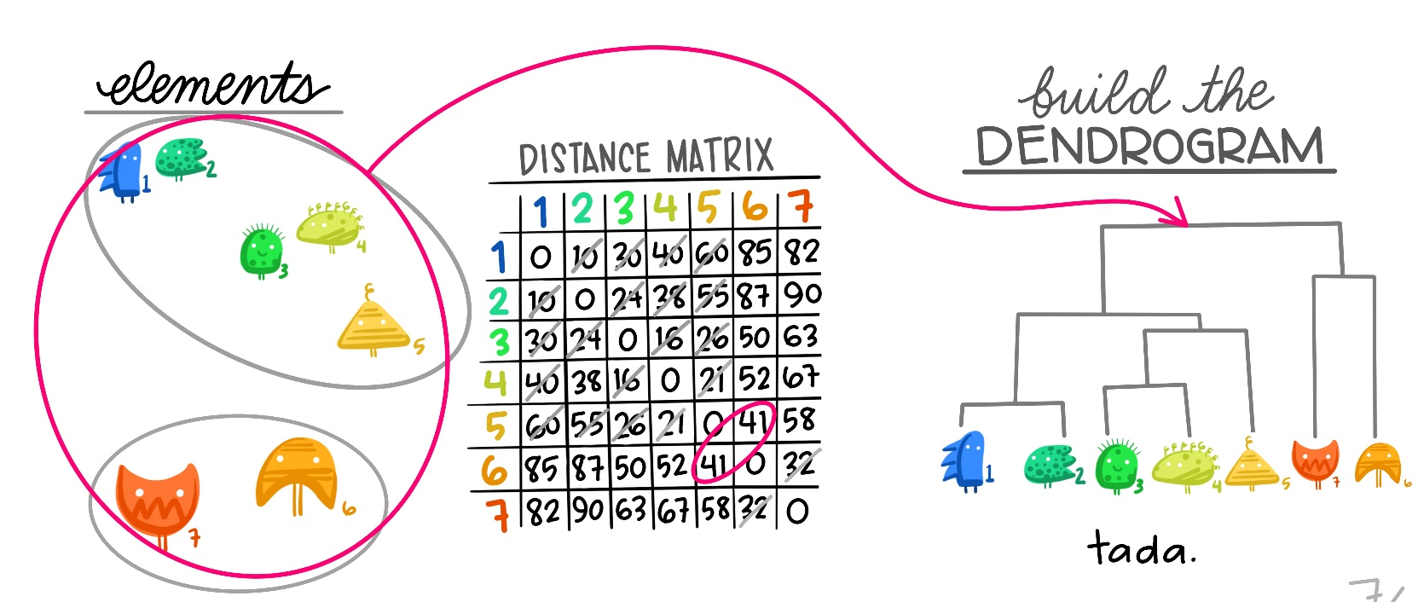
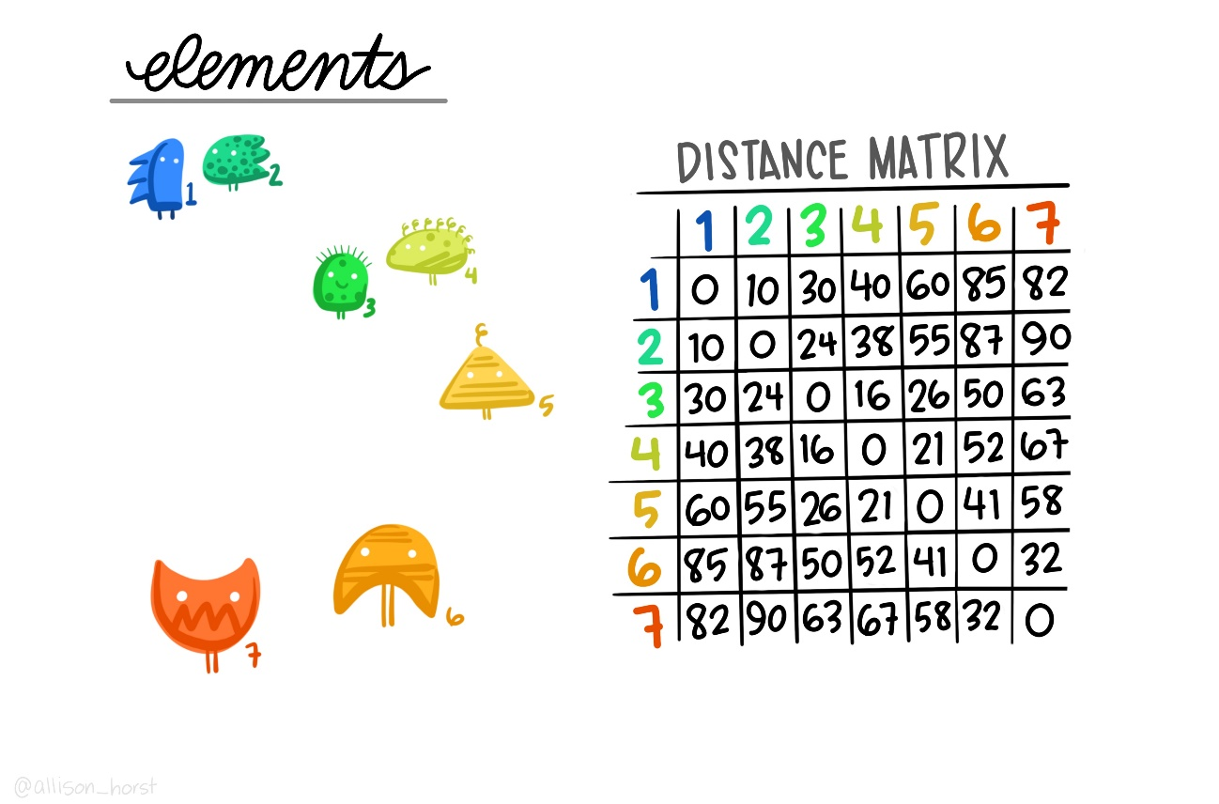
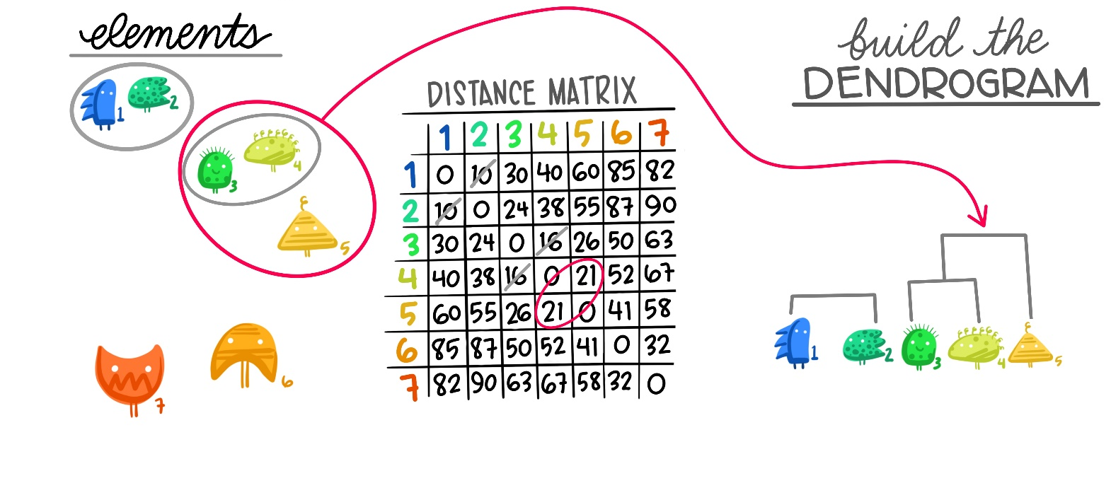
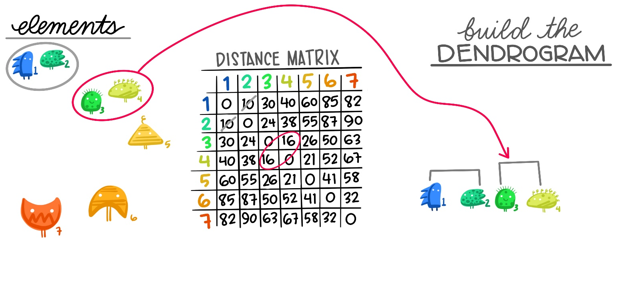
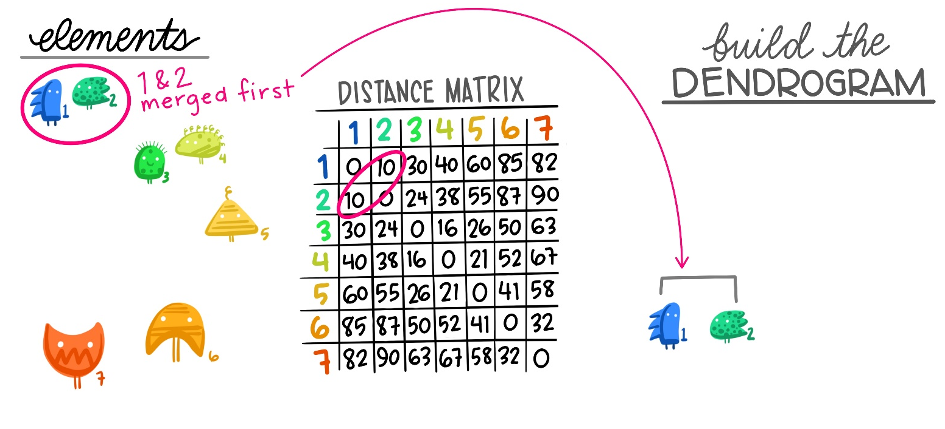





Hierarchical clustering: agglomerative clustering
The linkage distances between each of the data points is computed.
Points are clustered pairwise with their nearest neighbor.
Linkage distances between the clusters are computed.
Clusters are combined pairwise into larger clusters.
Steps 3 and 4 are repeated until all data points are in a single cluster.
Artwork by @allison_horst
Notes:
Hierarchical clustering creates clusters by either a divisive method or an agglomerative method. The divisive method is a top-down approach, starting with the entire dataset and then finding partitions in a stepwise manner. Agglomerative clustering is a bottom-up approach. In this lab, you will work with agglomerative clustering, commonly referred to as AGNES (AGglomerative NESting), which roughly works as follows:
The linkage distances between each of the data points is computed.
Points are clustered pairwise with their nearest neighbor.
Linkage distances between the clusters are computed.
Clusters are combined pairwise into larger clusters.
Steps 3 and 4 are repeated until all data points are in a single cluster.
A fundamental question in hierarchical clustering is: how do we measure the dissimilarity between two clusters of observations? You can compute this in a number of ways:
Ward's minimum variance method minimizes the total within-cluster variance. At each step, the pair of clusters with the smallest between-cluster distance are merged. It tends to produce more compact clusters.
Average linkage uses the mean pairwise distance between the members of the two clusters. It can vary in the compactness of the clusters it creates.
Complete or maximal linkage uses the maximum distance between the members of the two clusters. It tends to produce clusters that are compact contours by their borders, but they are not necessarily compact inside.

Slide 10
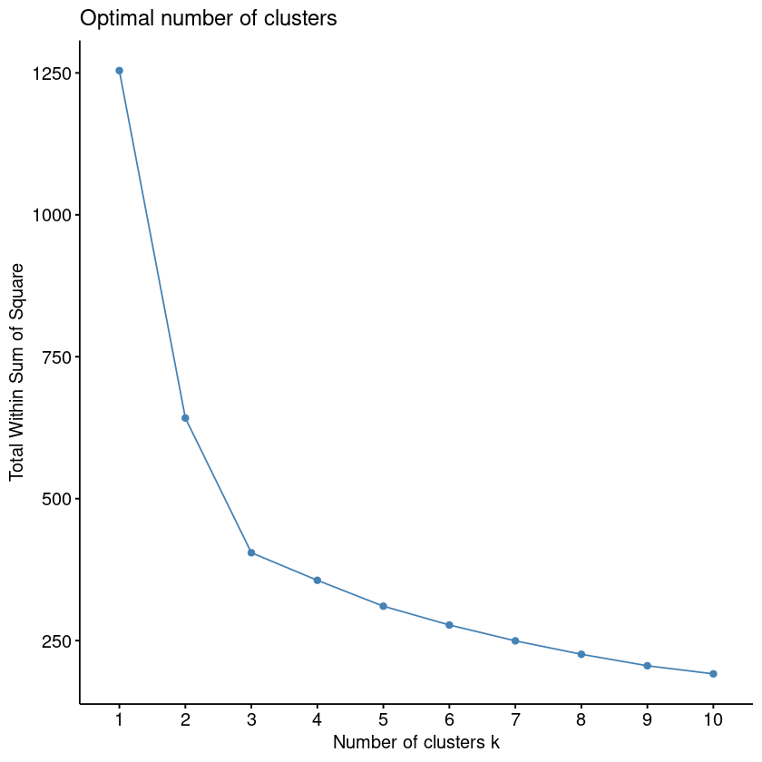
Within cluster sum of squares (WCSS)
Without knowing class labels, how do you know how many clusters to separate your data into?
One way is to create a series of clustering models with an incrementing number of clusters and then measure how tightly the data points are grouped within each cluster.
Notes:
Here's one of the fundamental problems with clustering: without knowing class labels, how do you know how many clusters to separate your data into?
Although hierarchical clustering doesn't require you to pre-specify the number of clusters, you still need to specify the number of clusters to extract.
One way is to use a data sample to create a series of clustering models with an incrementing number of clusters. Then you can measure how tightly the data points are grouped within each cluster. A metric often used to measure this tightness is the within cluster sum of squares (WCSS), with lower values meaning that the data points are closer. You can then plot the WCSS for each model.
Essentially, WCSS measures the variability of the observations within each cluster.

Slide 11
How to train and evaluate clustering models

Slide 12
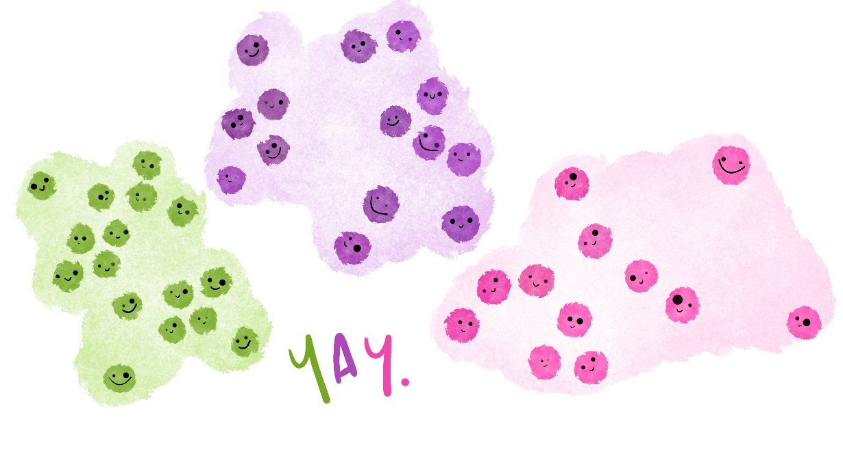
Challenge: Train a clustering model
In this challenge, you will separate a dataset consisting of three numeric features (A, B, and C) into clusters using both K-means and agglomerative clustering.
Artwork by @allison_horst

Slide 13

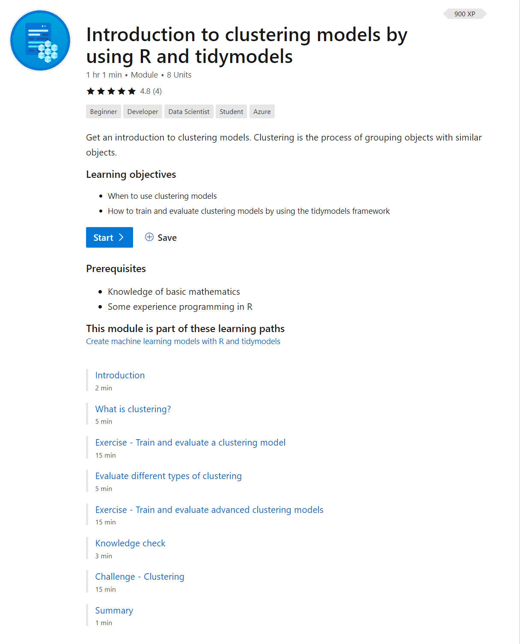
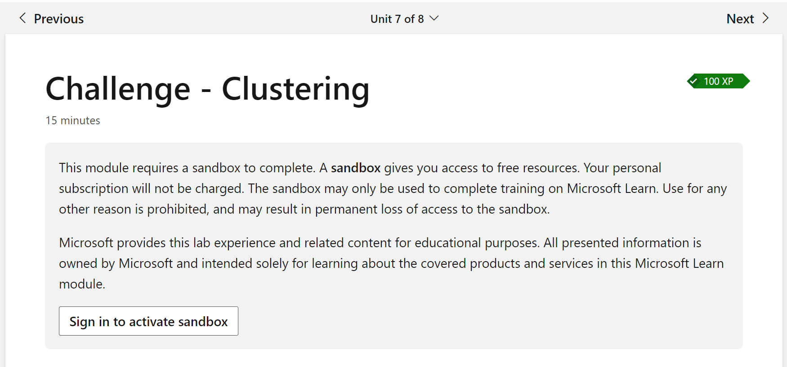

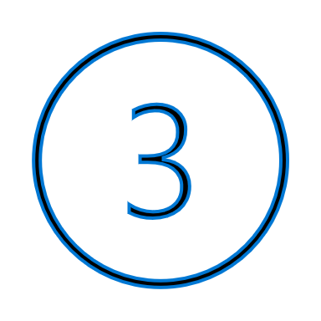

Code with us
Browse https://aka.ms/learn-clustering-with-R
Click on Unit 7: Challenge - Clustering
Sign in with your Microsoft or GitHub account to activate the sandbox

Slide 14
Knowledge check

Slide 15
Question 1
K-Means clustering is an example of which kind of machine learning?
  Unsupervised machine learning.
  Supervised machine learning.
  Reinforcement learning.
Notes:
Explanation: That is correct. Clustering is a form of unsupervised machine learning in which the training data does not include known labels.

Slide 16
Question 1
K-Means clustering is an example of which kind of machine learning?
  Unsupervised machine learning.
  Supervised machine learning.
  Reinforcement learning.
Notes:
Explanation: That is correct. Clustering is a form of unsupervised machine learning in which the training data does not include known labels.

Slide 17
Question 2
You are using the built-in `kmeans()` function in R to train a K-Means clustering model that groups observations into three clusters. How should you create the object of class "kmeans" to specify that you wish to obtain 3 clusters?
  kclust <- kmeans(nstart = 3)
  kclust <- kmeans(iter.max = 3)
  kclust <- kmeans(centers = 3)
Notes:
Explanation: That is correct. The centers parameter determines the number of clusters, k.

Slide 18
Question 2
You are using the built-in `kmeans()` function in R to train a K-Means clustering model that groups observations into three clusters. How should you create the object of class "kmeans" to specify that you wish to obtain 3 clusters?
  kclust <- kmeans(nstart = 3)
  kclust <- kmeans(iter.max = 3)
  kclust <- kmeans(centers = 3)
Notes:
Explanation: That is correct. The centers parameter determines the number of clusters, k.

Slide 19
Summary

Slide 20
Summary
  What is clustering
  Evaluate different type of clustering
  How to train and evaluate clustering models

